Slide 1
ImageNet-trained CNNs are biased towards texture; increasing shape bias improves accuracy and robustness Robert Geirhos, Claudio Michaelis, Patricia Rubisch, Felix A. Wichmann, Matthias Bethge, Wieland Brendel mainly University of Tübingen (& IMPRIS-IS)
Fabrice Beaumont Rheinische Friedrich-Wilhelms-Universität Bonn
30.09.2020

Slide 2
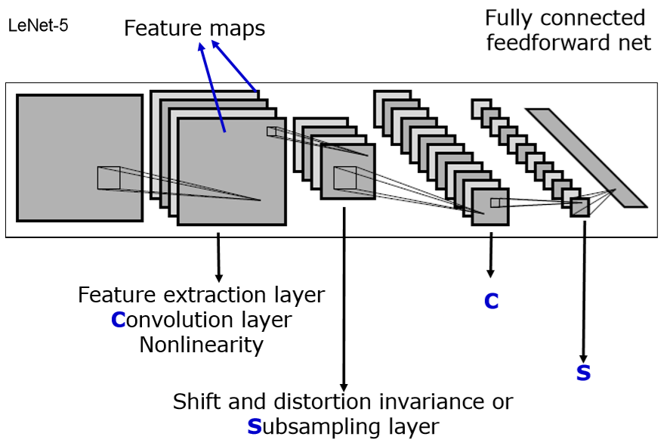
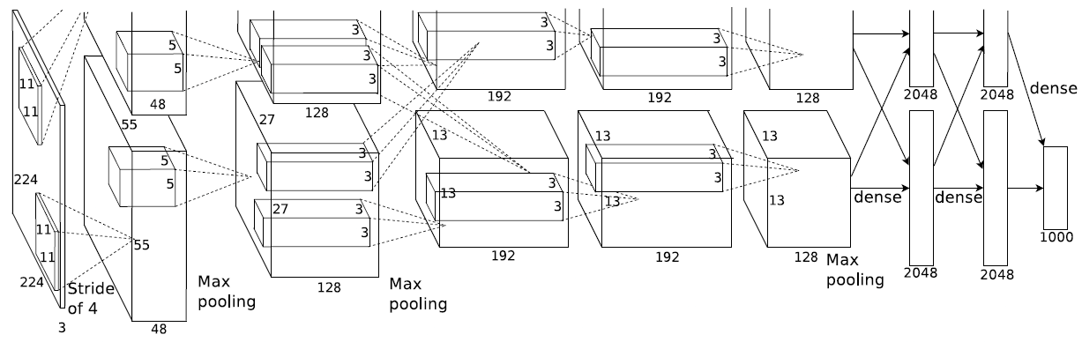
ImageNet-trained CNNs are biased towards texture; increasing shape bias improves accuracy and robustness )
(2012 - Alex Krizhevsky et al. – AlexNet)
1 / 33
Notes:
AlexNet
(KRIZHEVSKY, Alex; SUTSKEVER, Ilya; HINTON, Geoffrey E. Imagenet classification with deep convolutional neural networks. In: Advances in neural information processing systems. 2012. S. 1097-1105.)
APPLICATIONS:
Object recognition
Semantic segmentation
(e.g. for autonomous cars, facial recognition, medical imaging (recognizing chest cancer…))

Slide 3
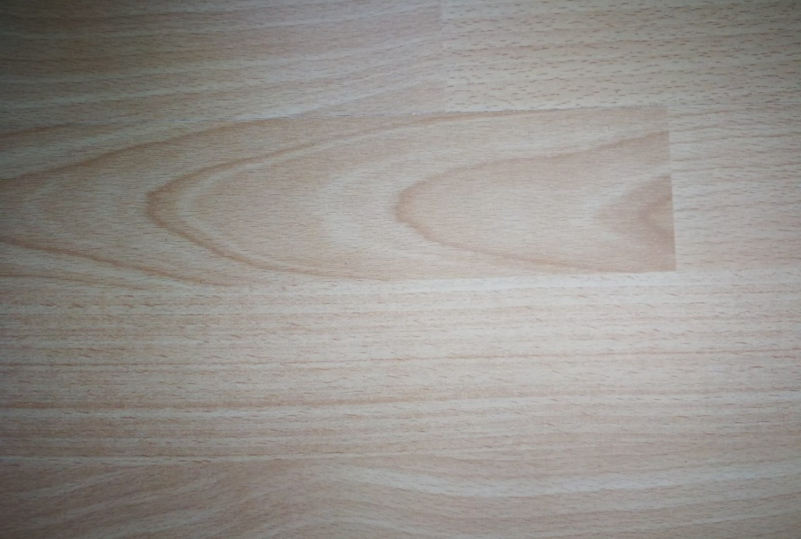
ImageNet-trained CNNs are biased towards texture; increasing shape bias improves accuracy and robustness )
(2012 - Alex Krizhevsky et al. – AlexNet)
1 / 33

Slide 4

ImageNet-trained CNNs are biased towards texture; increasing shape bias improves accuracy and robustness )
(2012 - Alex Krizhevsky et al. – AlexNet)
1 / 33

Slide 5
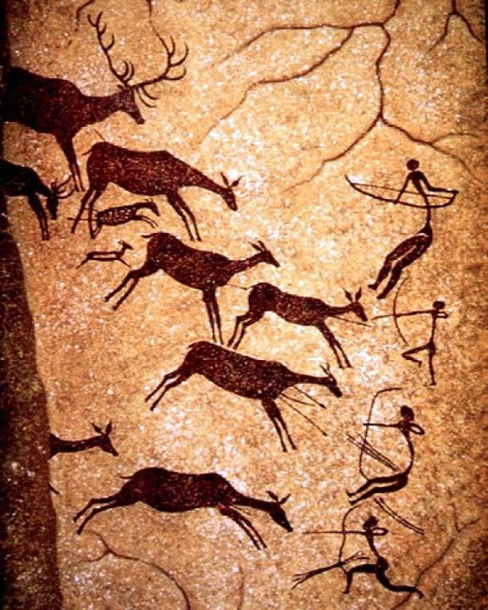
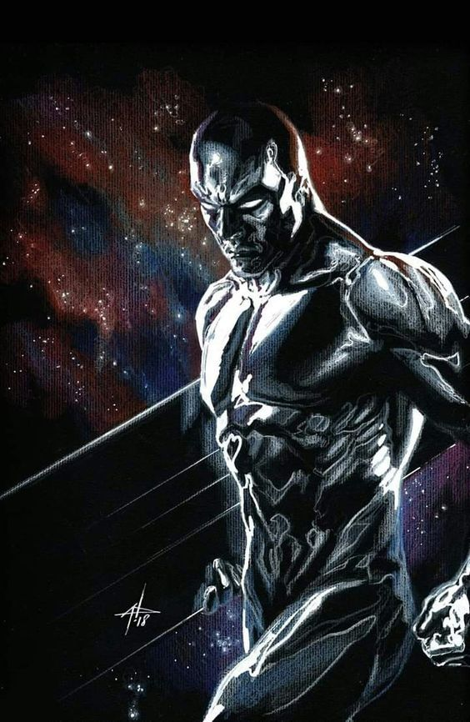
Motivation Importance of shape for object recognition
(2020; https://i.pinimg.com/564x/f5/bb/b4/f5bbb46820d7d3b9f41753f24db74516.jpg)
(2020; https://i.pinimg.com/564x/8e/34/f5/8e34f51699073da82c11d9995699498f.jpg)
2 / 33

Slide 6
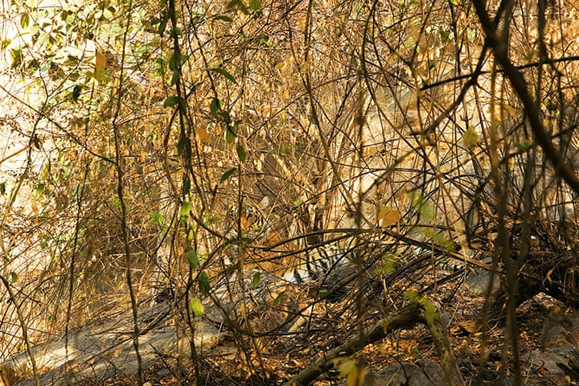
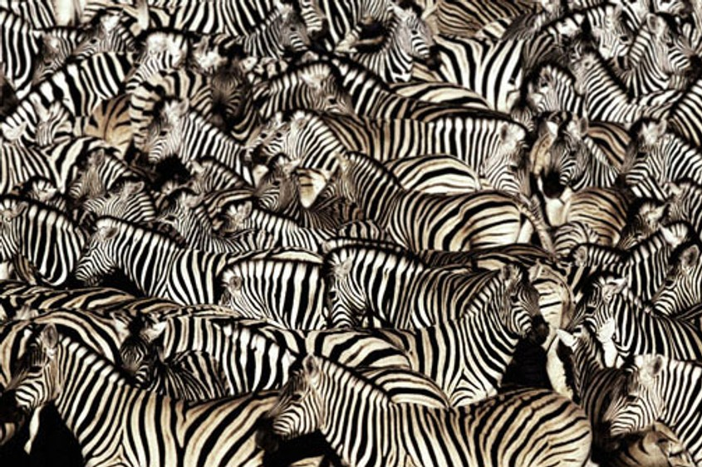
Motivation Importance of shape for object recognition
(2020; https://www.economist.com/img/b/1000/563/90/sites/default/files/images/print-edition/20120211_STP002_0.jpg)
(2020; https://i.redd.it/gmvyk1pz26p21.jpg)
3 / 33
Notes:
Usefullness of relying on shape:
Shape is more robust to natural distortions like: snow, rain (water), darkness, brightness
But: Shape is probably harder to „learn“, since
it comes in so many varieties. (perspectives, different poses of animals)
Texture for example stays more or less the same (if not removed by natural distortions)

Slide 7
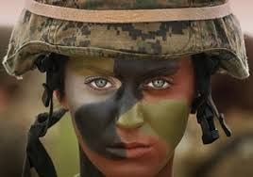
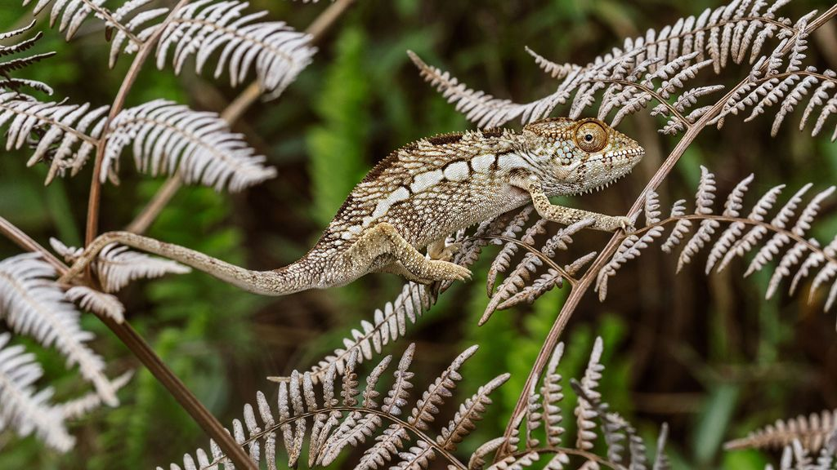
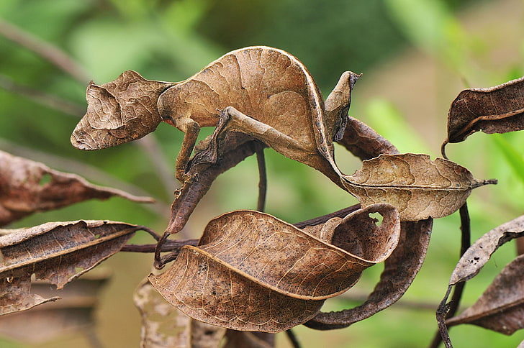
Motivation Importance of shape for object recognition
(2020; https://www.economist.com/img/b/1000/563/90/sites/default/files/images/print-edition/20120211_STP002_0.jpg)
(2020; https://i.redd.it/gmvyk1pz26p21.jpg)
(2020; https://i.pinimg.com/564x/84/e1/ 24/84e1240ca1d519a479310f24cc6a41e7.jpg)
(2020; https://static.nationalgeographic.de/files/styles/image_3200/public/chameleons-color-emotion-nationalgeographic_2298709.jpg?w=1024&h=576)
(2020; https://p4.wallpaperbetter.com/wallpaper/606/752/970/animals-reptiles-gecko-camouflage-wallpaper-preview.jpg)
3 / 33
Notes:
Usefullness of relying on shape:
Shape is more robust to natural distortions like: snow, rain (water), darkness, brightness
But: Shape is probably harder to „learn“, since
it comes in so many varieties. (perspectives, different poses of animals)
Texture for example stays more or less the same (if not removed by natural distortions)

Slide 8
Motivation
Humans (and other animals) excel at recognizing objects via their shape!
(Landau et al., 1988)
4 / 33
Notes:
Why ask?: Understanding - Decisions of NN
- Human vision (neuroscience)

Slide 9

Motivation
Humans (and other animals) excel at recognizing objects via their shape!
(Landau et al., 1988)
...But what about machines (here: CNNs)?
shape
texture
SHAPE
TEXTURE
4 / 33
Notes:
Why ask?: Understanding - Decisions of NN
- Human vision (neuroscience)

Slide 10
Introduction
Shape hypothesis: | CNNs learn to recognize and classify shapes
Support: | Zeiler & Fergus, 2014 Ritter et al., 2017 (contradicted by Hosseini et al. 2018)
5 / 33
Notes:
Zeiler & Fergus, 2014: Visualisation techniques like Deconvolutional Networks often highlight object parts in high-level CNN (learned) features
Ritter et al., 2017 CNN “shape bias” (like human children): shape more important than colour (for object classification) (contradicted by Hosseini et al. 2018) CNN perform bad on inverted images – where the shape is untouched!
Landau et al., 1988 Shape = most important cue for human (2-/3-year-olds & adults) object recognition (over size/texture) – may be induced by language
Cadieu et al., 2014 & Yamins et al., 2014 CNN ~ predictive model for human ventral stream object recognition
Kubilius et al., 2016 CNN ~ model of human shape perception

Slide 11
Introduction
Shape hypothesis: | CNNs learn to recognize and classify shapes
Support: | Zeiler & Fergus, 2014 Ritter et al., 2017 (contradicted by Hosseini et al. 2018)
“CNNs are ‘currently’ the most predictive model for human vental stream object recognition”
 | Landau et al., 1988 Cadieu et al., 2014 and Yamins et al., 2014 Kubilius et al., 2016
5 / 33
Notes:
Zeiler & Fergus, 2014: Visualisation techniques like Deconvolutional Networks often highlight object parts in high-level CNN (learned) features
Ritter et al., 2017 CNN “shape bias” (like human children): shape more important than colour (for object classification) (contradicted by Hosseini et al. 2018) CNN perform bad on inverted images – where the shape is untouched!
Landau et al., 1988 Shape = most important cue for human (2-/3-year-olds & adults) object recognition (over size/texture) – may be induced by language
Cadieu et al., 2014 & Yamins et al., 2014 CNN ~ predictive model for human ventral stream object recognition
Kubilius et al., 2016 CNN ~ model of human shape perception

Slide 12
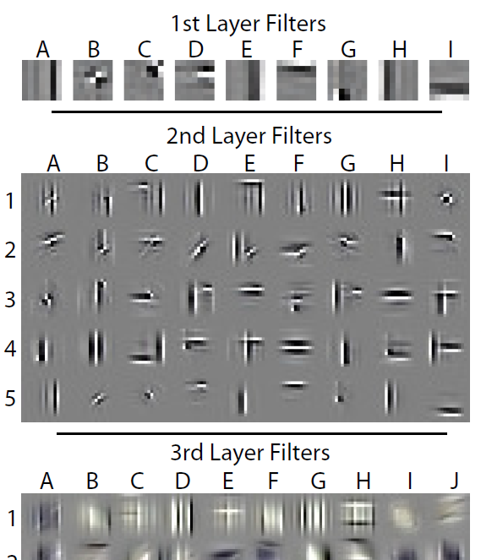
Introduction
Shape hypothesis: | CNNs learn to recognize and classify shapes
Support: | Zeiler & Fergus, 2014 Ritter et al., 2017 (contradicted by Hosseini et al. 2018)
“CNNs are ‘currently’ the most predictive model for human vental stream object recognition”
 | Landau et al., 1988 Cadieu et al., 2014 and Yamins et al., 2014 Kubilius et al., 2016
(Zeiler & Fergus, 2014)
6 / 33
Notes:
Idea of the „shape hierarchy“ – simple to complex
Zeiler & Fergus, 2014: Visualisation techniques like Deconvolutional Networks often highlight object parts in high-level CNN (learned) features
Ritter et al., 2017 CNN “shape bias” (like human children): shape more important than colour (for object classification) (contradicted by Hosseini et al. 2018) CNN perform bad on inverted images – where the shape is untouched!
Landau et al., 1988 Shape = most important cue for human (2-/3-year-olds & adults) object recognition (over size/texture) – may be induced by language
Cadieu et al., 2014 & Yamins et al., 2014 CNN ~ predictive model for human ventral stream object recognition
Kubilius et al., 2016 CNN ~ model of human shape perception

Slide 13
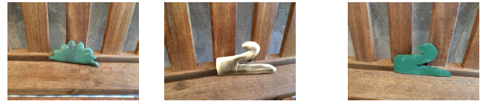
Introduction
Color match
Shape match
Probe
Shape hypothesis: | CNNs learn to recognize and classify shapes
Support: | Zeiler & Fergus, 2014 Ritter et al., 2017 (contradicted by Hosseini et al. 2018)
“CNNs are ‘currently’ the most predictive model for human vental stream object recognition”
 | Landau et al., 1988 Cadieu et al., 2014 and Yamins et al., 2014 Kubilius et al., 2016
(Ritter et al., 2017)
(Zeiler & Fergus, 2014)
6 / 33
Notes:
Idea of the „shape hierarchy“ – simple to complex
Zeiler & Fergus, 2014: Visualisation techniques like Deconvolutional Networks often highlight object parts in high-level CNN (learned) features
Ritter et al., 2017 CNN “shape bias” (like human children): shape more important than colour (for object classification) (contradicted by Hosseini et al. 2018) CNN perform bad on inverted images – where the shape is untouched!
Landau et al., 1988 Shape = most important cue for human (2-/3-year-olds & adults) object recognition (over size/texture) – may be induced by language
Cadieu et al., 2014 & Yamins et al., 2014 CNN ~ predictive model for human ventral stream object recognition
Kubilius et al., 2016 CNN ~ model of human shape perception

Slide 14
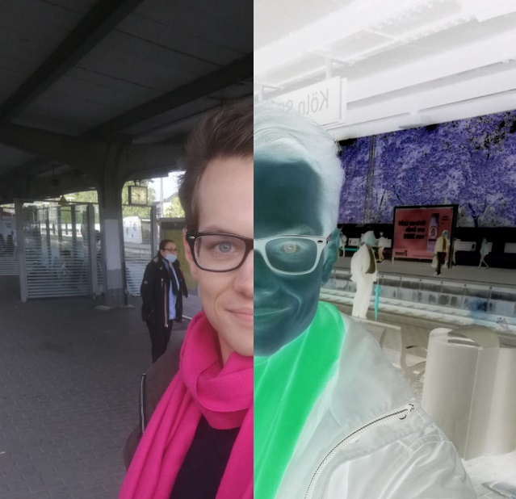
Introduction
Color match
Shape match
Probe
Shape hypothesis: | CNNs learn to recognize and classify shapes
Support: | Zeiler & Fergus, 2014 Ritter et al., 2017 (contradicted by Hosseini et al. 2018)
“CNNs are ‘currently’ the most predictive model for human vental stream object recognition”
 | Landau et al., 1988 Cadieu et al., 2014 and Yamins et al., 2014 Kubilius et al., 2016
(Ritter et al., 2017)
(Zeiler & Fergus, 2014)
Normal
Inverted
6 / 33
Notes:
Idea of the „shape hierarchy“ – simple to complex
Zeiler & Fergus, 2014: Visualisation techniques like Deconvolutional Networks often highlight object parts in high-level CNN (learned) features
Ritter et al., 2017 CNN “shape bias” (like human children): shape more important than colour (for object classification) (contradicted by Hosseini et al. 2018) CNN perform bad on inverted images – where the shape is untouched!
Landau et al., 1988 Shape = most important cue for human (2-/3-year-olds & adults) object recognition (over size/texture) – may be induced by language
Cadieu et al., 2014 & Yamins et al., 2014 CNN ~ predictive model for human ventral stream object recognition
Kubilius et al., 2016 CNN ~ model of human shape perception

Slide 15
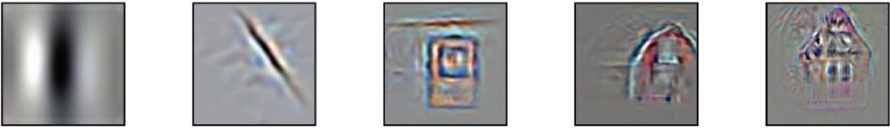
Introduction
Color match
Shape match
Probe
Shape hypothesis: | CNNs learn to recognize and classify shapes
Support: | Zeiler & Fergus, 2014 Ritter et al., 2017 (contradicted by Hosseini et al. 2018)
“CNNs are ‘currently’ the most predictive model for human vental stream object recognition”
 | Landau et al., 1988 Cadieu et al., 2014 and Yamins et al., 2014 Kubilius et al., 2016
(Ritter et al., 2017)
(Zeiler & Fergus, 2014)
Normal
Inverted
Layer 1
Layer 2
Layer 3
Layer 4
Layer 5
(Kriegeskorte (Ann. Review Vision Science 1:417-46), 2015)
6 / 33
Notes:
Idea of the „shape hierarchy“ – simple to complex
Zeiler & Fergus, 2014: Visualisation techniques like Deconvolutional Networks often highlight object parts in high-level CNN (learned) features
Ritter et al., 2017 CNN “shape bias” (like human children): shape more important than colour (for object classification) (contradicted by Hosseini et al. 2018) CNN perform bad on inverted images – where the shape is untouched!
Landau et al., 1988 Shape = most important cue for human (2-/3-year-olds & adults) object recognition (over size/texture) – may be induced by language
Cadieu et al., 2014 & Yamins et al., 2014 CNN ~ predictive model for human ventral stream object recognition
Kubilius et al., 2016 CNN ~ model of human shape perception

Slide 16
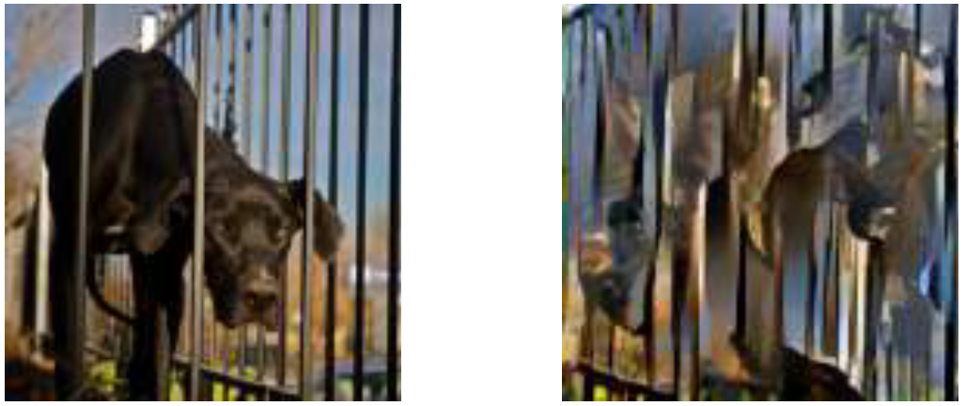
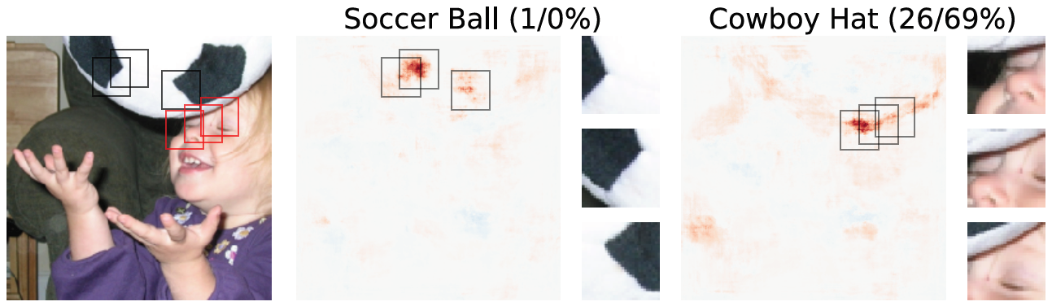
Introduction
Texture hypothesis: | CNNs learn to recognize and classify textures
Support: | Gatys et al., 2015 and 2016 Gatys et al., 2017 and Brendel & Bethge, 2019 Eckstein et al., 2017 Wollis et al., 2017 and Laskar et al., 2018 and Long & Konkle, 2018 Funke et al., 2017 Geirhos et al., 2018 Gondal et al., 2018 Gokaslan et al., 2018 Ustyuzhaninov et al., 2018 Brendel & Bethge, 2019 Ballester & de Aruújo, 2016; Yu et al., 2017
(Brendel & Bethge, 2019)
2019; Brendel & Bethge
7 / 33
Notes:
Gatys et al., 2015 linear classifier on top of a CNNs texture representation performs well
Gatys et al., 2016 CNNs robust to style transfer (texture-based generative modelling)
Gatys et al., 2017 and Brendel & Bethge, 2019 CNNs robust to destroyed global shape structure of texturized images
Eckstein et al., 2017 CNNs robust to changed object size relative to context
Wollis et al., 2017 and Laskar et al., 2018 and Long & Konkle, 2018 CNNs perform similar to human-like texture representations but not human-like contour repress.
Funke et al., 2017 CNNs robust to static & dynamic texture synthesis (texture-based generative modelling)
Geirhos et al., 2018 CNNs robust to changed object colour relative to context
Gondal et al., 2018 CNNs robust to single image super-resolution (texture-based generative modelling)
Gokaslan et al., 2018 CNN based shape transfer seems to be difficult
Brendel & Bethge, 2019 CNNs robust to scrambled shapes
Ballester & de Aruújo, 2016; Yu et al., 2017 CNNs susceptible to missing texture information
Ustyuzhaninov et al., 2018 Segmentation model trained on database of synthetic texture images transfers to natural images and videos

Slide 17
Introduction
Texture hypothesis: | CNNs learn to recognize and classify textures
Support: | Gatys et al., 2015 and 2016 Gatys et al., 2017 and Brendel & Bethge, 2019 Eckstein et al., 2017 Wollis et al., 2017 and Laskar et al., 2018 and Long & Konkle, 2018 Funke et al., 2017 Geirhos et al., 2018 Gondal et al., 2018 Gokaslan et al., 2018 Ustyuzhaninov et al., 2018 Brendel & Bethge, 2019 Ballester & de Aruújo, 2016; Yu et al., 2017
(Brendel & Bethge, 2019)
(Geirhos et al., 2018)
7 / 33
Notes:
Gatys et al., 2015 linear classifier on top of a CNNs texture representation performs well
Gatys et al., 2016 CNNs robust to style transfer (texture-based generative modelling)
Gatys et al., 2017 and Brendel & Bethge, 2019 CNNs robust to destroyed global shape structure of texturized images
Eckstein et al., 2017 CNNs robust to changed object size relative to context
Wollis et al., 2017 and Laskar et al., 2018 and Long & Konkle, 2018 CNNs perform similar to human-like texture representations but not human-like contour repress.
Funke et al., 2017 CNNs robust to static & dynamic texture synthesis (texture-based generative modelling)
Geirhos et al., 2018 CNNs robust to changed object colour relative to context
Gondal et al., 2018 CNNs robust to single image super-resolution (texture-based generative modelling)
Gokaslan et al., 2018 CNN based shape transfer seems to be difficult
Brendel & Bethge, 2019 CNNs robust to scrambled shapes
Ballester & de Aruújo, 2016; Yu et al., 2017 CNNs susceptible to missing texture information
Ustyuzhaninov et al., 2018 Segmentation model trained on database of synthetic texture images transfers to natural images and videos

Slide 18
Introduction
Texture hypothesis: | CNNs learn to recognize and classify textures
Support: | Gatys et al., 2015 and 2016 Gatys et al., 2017 and Brendel & Bethge, 2019 Eckstein et al., 2017 Wollis et al., 2017 and Laskar et al., 2018 and Long & Konkle, 2018 Funke et al., 2017 Geirhos et al., 2018 Gondal et al., 2018 Gokaslan et al., 2018 Ustyuzhaninov et al., 2018 Brendel & Bethge, 2019 Ballester & de Aruújo, 2016; Yu et al., 2017
(Brendel & Bethge, 2019)
(Geirhos et al., 2018)
(Ballester & de Aruújo, 2016)
7 / 33
Notes:
Gatys et al., 2015 linear classifier on top of a CNNs texture representation performs well
Gatys et al., 2016 CNNs robust to style transfer (texture-based generative modelling)
Gatys et al., 2017 and Brendel & Bethge, 2019 CNNs robust to destroyed global shape structure of texturized images
Eckstein et al., 2017 CNNs robust to changed object size relative to context
Wollis et al., 2017 and Laskar et al., 2018 and Long & Konkle, 2018 CNNs perform similar to human-like texture representations but not human-like contour repress.
Funke et al., 2017 CNNs robust to static & dynamic texture synthesis (texture-based generative modelling)
Geirhos et al., 2018 CNNs robust to changed object colour relative to context
Gondal et al., 2018 CNNs robust to single image super-resolution (texture-based generative modelling)
Gokaslan et al., 2018 CNN based shape transfer seems to be difficult
Brendel & Bethge, 2019 CNNs robust to scrambled shapes
Ballester & de Aruújo, 2016; Yu et al., 2017 CNNs susceptible to missing texture information
Ustyuzhaninov et al., 2018 Segmentation model trained on database of synthetic texture images transfers to natural images and videos

Slide 19
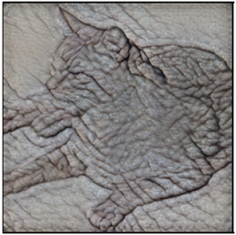
Results - Overview
1. CNNs (mostly) use textures for the classification task
2. This texture-bias can be replaced by a shape-bias by using a suitable database
3. CNNs with a shape-bias are more robust to (unseen) noise
(Geirhos et al., 2019)
8 / 33

Slide 20
Result 1
1. CNNs (mostly) use textures for the classification task
Idea: Remove textures in the images while preserving shape
Method: Style-transfer (Huang & Belongie, 2017)
(Geirhos et al., 2019)
9 / 33
Notes:
Most recent news! 28.09.2020 / yesterday:
New paper proposing a style-transfer application for video stylization
“Interactive Video Stylization Using Few-Shot Patch-Based Training“ by ONDŘEJ TEXLER, DAVID FUTSCHIK, (Czech Technical University in Prague)

Slide 21
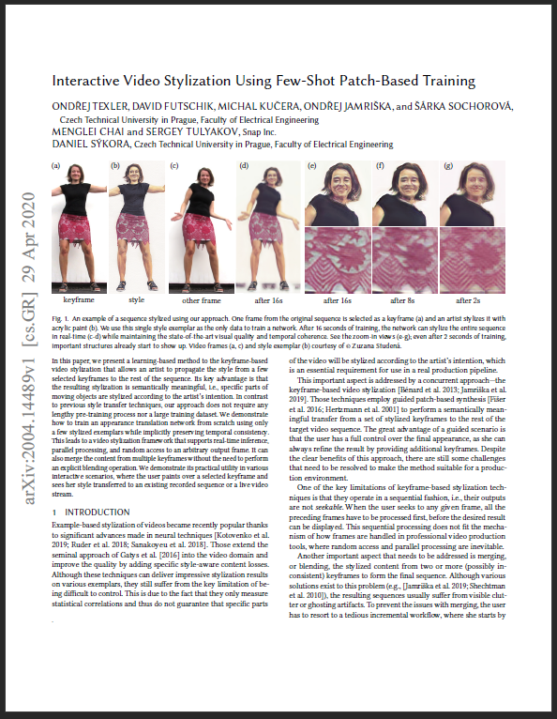
Result 1
1. CNNs (mostly) use textures for the classification task
Idea: Remove textures in the images while preserving shape
Method: Style-transfer (Huang & Belongie, 2017)
28.09.2020
“Interactive Video Stylization Using Few-Shot Patch-Based Training”
Texler et al., Czech Technical University
(Geirhos et al., 2019)
9 / 33
Notes:
Most recent news! 28.09.2020 / yesterday:
New paper proposing a style-transfer application for video stylization
“Interactive Video Stylization Using Few-Shot Patch-Based Training“ by ONDŘEJ TEXLER, DAVID FUTSCHIK, (Czech Technical University in Prague)
(Already commented by Károly Zsolnai-Fehér's / “Two minute papers” youtube channel)

Slide 22
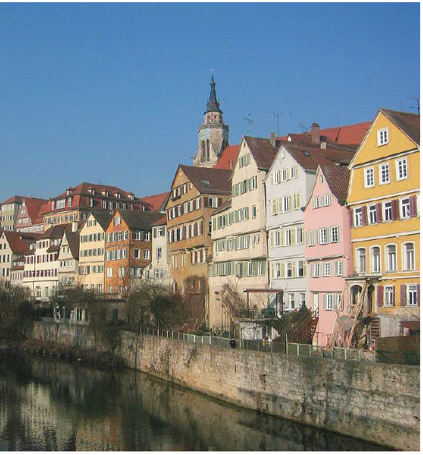
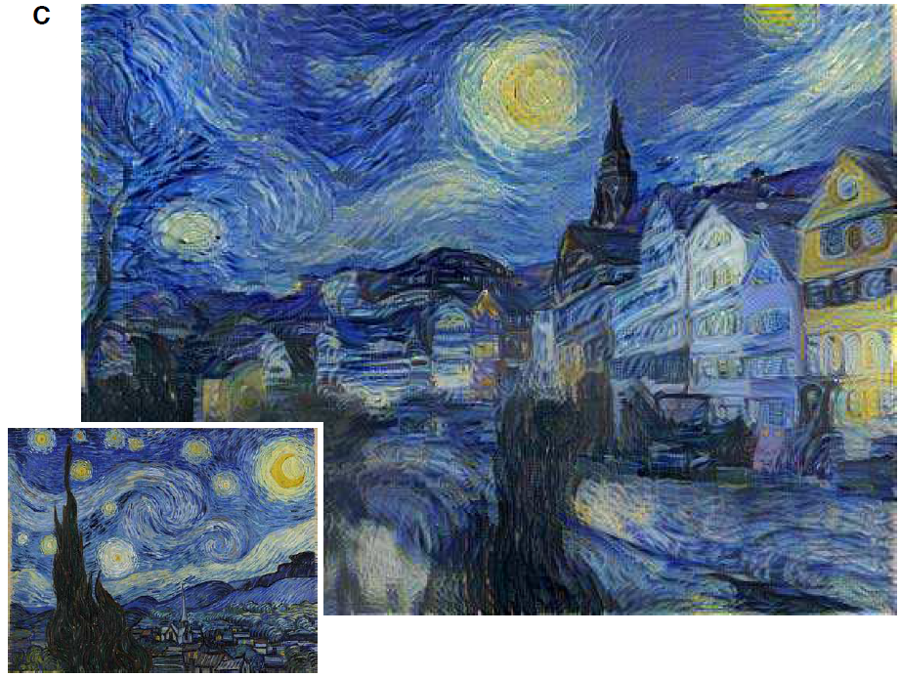
Methods for result 1 Style-transfer
Shape
Style
Style-transfer
(Gatys et al., 2016)
10 / 33
Notes:
Originally intrudced by Gatys et al. (2016)
(But Huang & Belongie, 2017 is faster)

Slide 23
Methods for result 1 Style-transfer
Shape
Style
Style-transfer
(Gatys et al., 2016)
10 / 33

Slide 24
Methods for result 1 Texture-shape cue conflict
Shape
Style
Texture
Style-transfer
11 / 33

Slide 25
Methods for result 1 Texture-shape cue conflict
Shape
Style
Texture
Style-transfer
Texture-shape cue conflict
11 / 33

Slide 26
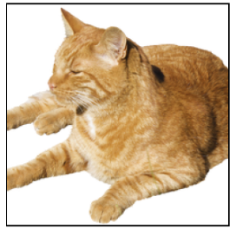
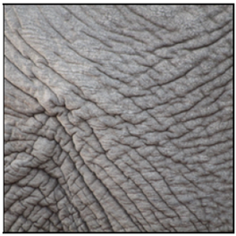
Methods for result 1 Texture-shape cue conflict
Shape
Texture
Texture-shape cue conflict
(Geirhos et al., 2019)
11 / 33

Slide 27
Methods for result 1 Texture-shape cue conflict
Shape
Texture
Texture-shape cue conflict
(Geirhos et al., 2019)
11 / 33
Notes:
(Figure 1)

Slide 28

Experimental set-up for result 1 ImageNet
WordNet hierarchy
100.000 synsets
Average of over 500 images / node
(2020; http://www.image-net.org; snapshot)
12 / 33
Notes:
WordNet = lexical database of English (Princeton University)

Slide 29
Experimental set-up for result 1
48 560 trials, 97 humans
Following the paradigm for comparability of human & machine experiments (by Geishos et al., 2018)
Only use images which where sampled correctly by the CNN
13 / 33

Slide 30
Experimental set-up for result 1 Human trials
Fixation square
300 ms
14 / 33

Slide 31

Experimental set-up for result 1 Human trials
300 ms
Stimulus image
300 ms
14 / 33

Slide 32
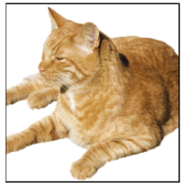
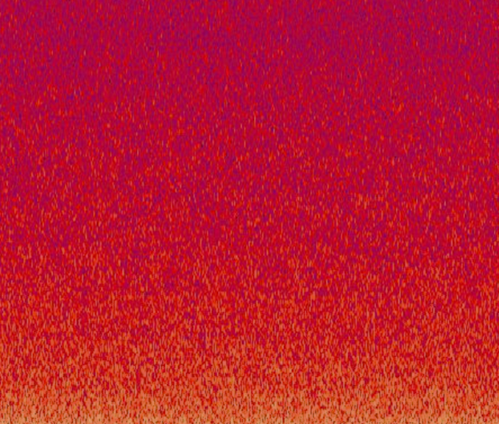
Experimental set-up for result 1 Human trials
300 ms
300 ms
Full-contrast pink noise mask
200 ms
(2020; https://upload.wikimedia.org/wikipedia/commons/7/76/Noise.jpg)
14 / 33
Notes:
Minimization of the feedback processing in the human visual system
(CNN is „just feed-forward“, too)

Slide 33
Experimental set-up for result 1 Human trials
300 ms
300 ms
200 ms
Click at the category “Guess if unsure“
1500 ms
(2020; https://upload.wikimedia.org/wikipedia/commons/7/76/Noise.jpg)
14 / 33
Notes:
The categories are known and represented by pictograms

Slide 34
Experimental set-up for result 1 Human trials
300 ms
300 ms
200 ms
1500 ms =1.5 sec!!
airplane | bear | bicycle | bird
boat | bottle | car | cat
chair | clock | dog | elephant
keyboard | knife | oven | truck
= 16-class-ImageNet (Geirhos et al., 2018)
(2020; https://upload.wikimedia.org/wikipedia/commons/7/76/Noise.jpg)
14 / 33

Slide 35
Experimental set-up for result 1 Human trials
AlexNet (Krizhevsky et al., 2012)
97 Humans
vs
GoogLeNet (Szegedy et al., 2015)
VGG-16 (Simonyan & Zisserman, 2015)
ResNet-50 (He et al., 2015)
15 / 33

Slide 36
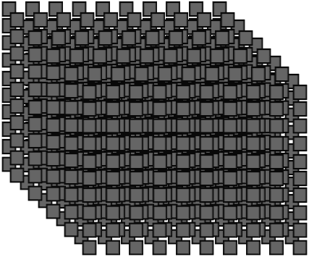
Experimental set-up for result 1 Human trials
AlexNet (Krizhevsky et al., 2012)
97 Humans
vs
GoogLeNet (Szegedy et al., 2015)
VGG-16 (Simonyan & Zisserman, 2015)
ResNet-50 (He et al., 2015)
“WordNet hierarchy“
(Miller, 1995)
1000 classes
15 / 33

Slide 37
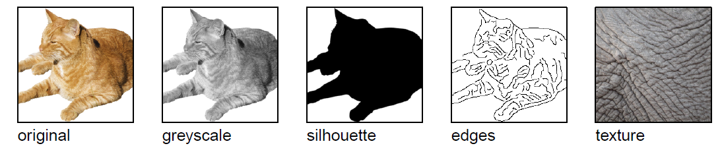
Experimental evaluation for result 1
x160
x160
x48
x160
x160
x1280
Original
Greyscale
Texture
Silhouette
Object shape
Texture-shape cue conflict
(Geirhos et al., 2019)
16 / 33
Notes:
Original: natural colour images, white background (160 images = 10 per one of the 16 categories)
Greyscale: (skimage.color.rgb2gray)
Silhouette: convert to .bmp (command line), convert to .svg (using potrace), convert to .png (command line) + manually checking every image and correcting using GIMP if necessary
Object shape: edge based representation/ describe 3D contours (Canny edge extractor (MATLAB))
Texture: 48 natural colour images of textures (3 per one of the 16 categories) – „full-width patches of animal (skin, fur) or repeted man-mad objects“ (e.g. Bottles see top slides)
CNNs had problems to shift from natural images (training data) to sketches (“silhouette“, “object shape“)
CNNs use texture for object classification
(Figure 2 – and kind of 1)

Slide 38
Experimental evaluation for result 1
x160
x160
x48
x160
x160
x1280
Original
Greyscale
Texture
Silhouette
Object shape
Texture-shape cue conflict
(Geirhos et al., 2019)
16 / 33
Notes:
Original: natural colour images, white background (160 images = 10 per one of the 16 categories)
Greyscale: (skimage.color.rgb2gray)
Silhouette: convert to .bmp (command line), convert to .svg (using potrace), convert to .png (command line) + manually checking every image and correcting using GIMP if necessary
Object shape: edge based representation/ describe 3D contours (Canny edge extractor (MATLAB))
Texture: 48 natural colour images of textures (3 per one of the 16 categories) – „full-width patches of animal (skin, fur) or repeted man-mad objects“ (e.g. Bottles see top slides)
CNNs had problems to shift from natural images (training data) to sketches (“silhouette“, “object shape“)
CNNs use texture for object classification
(Figure 2 – and kind of 1)

Slide 39
Experimental evaluation for result 1
GoogLeNet
AlexNet
ResNet-50
VGG-16
x160
x160
x48
x160
x160
x1280
Original
Greyscale
Texture
Silhouette
Object shape
Texture-shape cue conflict
(Geirhos et al., 2019)
16 / 33
Notes:
Original: natural colour images, white background (160 images = 10 per one of the 16 categories)
Greyscale: (skimage.color.rgb2gray)
Silhouette: convert to .bmp (command line), convert to .svg (using potrace), convert to .png (command line) + manually checking every image and correcting using GIMP if necessary
Object shape: edge based representation/ describe 3D contours (Canny edge extractor (MATLAB))
Texture: 48 natural colour images of textures (3 per one of the 16 categories) – „full-width patches of animal (skin, fur) or repeted man-mad objects“ (e.g. Bottles see top slides)
CNNs had problems to shift from natural images (training data) to sketches (“silhouette“, “object shape“)
CNNs use texture for object classification
(Figure 2 – and kind of 1)

Slide 40
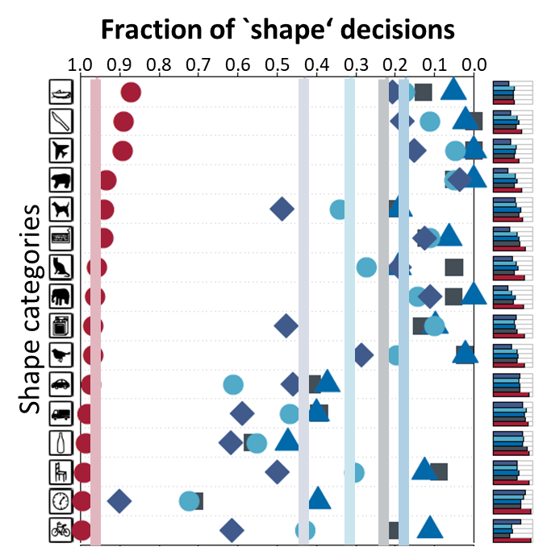
Experimental evaluation for result 1
AlexNet
GoogLeNet
VGG-16
ResNet-50
(Geirhos et al., 2019)
17 / 33
Notes:
Similar results for: - ResNet-152
- DenseNet-121
Squeezenet1_1
(Missing legend/explenation in the github)
(Figure 4)

Slide 41
Experimental evaluation for result 1
shape
texture
AlexNet
GoogLeNet
VGG-16
ResNet-50
(Geirhos et al., 2019)
17 / 33
Notes:
Similar results for: - ResNet-152
- DenseNet-121
Squeezenet1_1
(Missing legend/explenation in the github)
(Figure 4)

Slide 42
Results - Overview
1. CNNs (mostly) use textures for the classification task
(Geirhos et al., 2019)
18 / 33
Notes:
Goal: Induce shape bias? (like human) Treat texture as nuisance factor
(Overall parameters: Architectural changes, use of loss function, database selection)
Hidden Assumption: Texture-bias is NOT by design of the CNN
The database allowed to use this texture-shortcut (in both training and texting database!!)

Slide 43
Results - Overview
1. CNNs (mostly) use textures for the classification task
2. This texture-bias can be replaced by a shape-bias by using a suitable database
(Geirhos et al., 2019)
18 / 33

Slide 44
Results - Overview
1. CNNs (mostly) use textures for the classification task
2. This texture-bias can be replaced by a shape-bias by using a suitable database
Idea: Adapt the ImageNet database
Method: Style-transfer (AdaIN, Huang & Belongie, 2017) to replace the database with images of preserved shape but unreliable texture
(Geirhos et al., 2019)
18 / 33
Notes:
AdaIN – Adaptive Instance Normalization layer – „arbitrary style transfer in real-time“
Why not use Gatys stlye transfer?
use different stylization techniques (Huang&Belongie for training, Gatys for testing)
Gatys method is slower (iterative optimization process)
(Code to create SIN is avaliable on github.)

Slide 45
Experimental set-up for result 2 SIN
ImageNet (IN) → Stylized ImageNet (SIN)
Texture: Kaggle‘s “Painter by Numbers“ data set
IN
SIN
(Geirhos et al., 2019)
19 / 33
Notes:
Replace IN-image with exactl ONE random stylized image
(Style transfer – Huang & Belongie, 2017 – (AdaIN)
(Painter by Numbers data set = 79.434 paintings
(Figure 3)

Slide 46
Experimental set-up for result 2 SIN
ImageNet (IN) → Stylized ImageNet (SIN)
Texture: Kaggle‘s “Painter by Numbers“ data set
IN
SIN
(Geirhos et al., 2019)
19 / 33
Notes:
Replace IN-image with exactl ONE random stylized image
(Style transfer – Huang & Belongie, 2017 – (AdaIN)
(Painter by Numbers data set = 79.434 paintings
(Figure 3)

Slide 47
Experimental evaluation for result 2
ResNet-50 top-5 accuracies |  | Trained on
 |  | IN | SIN
Evaluated on | IN | 92.9 %
 | SIN |  | 79,0 %
20 / 33
Notes:
→ Learning on SIN is harder than on IN

Slide 48
Experimental evaluation for result 2
ResNet-50 top-5 accuracies |  | Trained on
 |  | IN | SIN
Evaluated on | IN | 92.9 %
 | SIN | 16.4 % | 79,0 %
20 / 33
Notes:
→ Learning on IN poorly generalizes to SIN

Slide 49
Experimental evaluation for result 2
ResNet-50 top-5 accuracies |  | Trained on
 |  | IN | SIN
Evaluated on | IN | 92.9 % | 82.6 %
 | SIN | 16.4 % | 79,0 %
20 / 33
Notes:
Learning on SIN generalizes well to IN
Further evaluation of effectiveness of SIN: - BadNets performance dropped from 70% (IN) to 10% (SIN) [ResNet-50 with limited receptive field, Brendel&Bethge 2019]
(= Table 1)

Slide 50
Recall
shape
texture
On IN:
AlexNet
GoogLeNet
VGG-16
ResNet-50
(Geirhos et al., 2019)
21 / 33
Notes:
OLD statistic – IMAGE NET

Slide 51
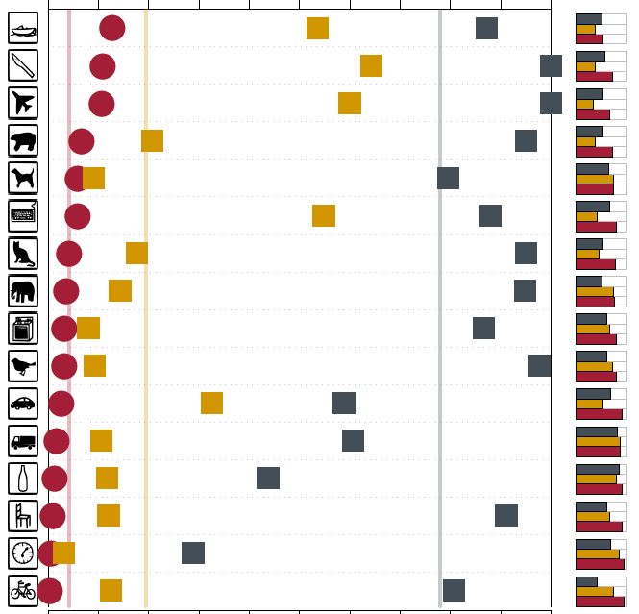
Experimental evaluation for result 2
shape
texture
ResNet-50 (IN)
ResNet-50 (SIN)
(Geirhos et al., 2019)
23 / 33
Notes:
Not explicitly said in the paper but: - Note that the training on SIN and evaluation on texture-cue conflict ONLY can be done by the shape
Similar results for AlexNet and VGG-16
No data for GoogLeNet since network training was performed in PyTorch – which does not provide a GoogLeNet architecture
(Figure 5)

Slide 52
Results - Overview
1. CNNs (mostly) use textures for the classification task
2. This texture-bias can be replaced by a shape-bias by using a suitable database
(Geirhos et al., 2019)
24 / 33

Slide 53
Results - Overview
1. CNNs (mostly) use textures for the classification task
2. This texture-bias can be replaced by a shape-bias by using a suitable database
3. CNNs with a shape-bias are more robust to (unseen) noise
(Geirhos et al., 2019)
24 / 33

Slide 54
Experimental evaluation for result 3 ResNet-50 – Performance
Training | top-1 ImageNet [accuracy %] | top-5 ImageNet [accuracy %]
IN | 76.1 | 92.7
SIN | 60.2 | 82.6
SIN + IN | 74.6 | 92.1
SIN + IN (& fine-tuning) | 76.7 | 93.3
(Geirhos et al., 2019)
25 / 33
Notes:
(Table 2)

Slide 55

Experimental evaluation for result 3 ResNet-50 – Transfer learning
Training | top-1 ImageNet [accuracy %] | top-5 ImageNet [accuracy %] | PASCAL VOC [mAP50 %]
IN | 76.1 | 92.7 | 70.7
SIN | 60.2 | 82.6 | 70.6
SIN + IN | 74.6 | 92.1 | 74.0
SIN + IN (& fine-tuning) | 76.7 | 93.3 | 75.1
Transfer learning
(Geirhos et al., 2019)
25 / 33
Notes:
Pascal VOC: standardised image data sets for object recognition („Visual Object Classes Challenge“)
mAP50 = mean average precision (True positive/ all positives)
50 = IoU = Intersection over union – how much overlaps the predicted boundary [area] with the ground thruth (the real object boundary) [area]
50 = PASCAL VOC threshold to have a positive prediction (at least 50% of the computed boundary overlaps with the real boundary)
(Table 2)

Slide 56

Experimental evaluation for result 3 ResNet-50 – Transfer learning
Training | top-1 ImageNet [accuracy %] | top-5 ImageNet [accuracy %] | PASCAL VOC [mAP50 %] | MS COCO [mAP50 %]
IN | 76.1 | 92.7 | 70.7 | 52.3
SIN | 60.2 | 82.6 | 70.6 | 51.9
SIN + IN | 74.6 | 92.1 | 74.0 | 53.8
SIN + IN (& fine-tuning) | 76.7 | 93.3 | 75.1 | 55.2
Transfer learning
(2020; https://cocodataset.org/images/coco-logo.png and http://host.robots.ox.ac.uk/pascal/VOC/pascal2.png)
(Geirhos et al., 2019)
25 / 33
Notes:
MS COCO: Object detection, segmentation and captioning dataset („Common Objects in Context“)
For object detection: shape-based decision > texture-based (since the borders of the object align with the shape)
Pascal VOC/ COCO on Faster R-CNN (object detection architecture by Ross Girshick et al., 2015) using YOLO and SSD networks (you look only once, single shot detector)
Similar results for ResNet-152 (table 4)
(Table 2)

Slide 57
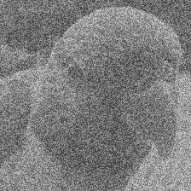
Experimental set-up for result 3 Different noise
Noise (in the test-data):
Unifom
Low contrast
High-pass filter
Low-pass filter
Eidolon perturbations
(Geirhos et al., 2019)
26 / 33
Notes:
IN-trained CNN generalize poorly towards many distortions ⬅ p.9 Dodge & Karam, 2017, Geiros et. Al. 2017/2018
SIN transfer well!
All distortions reported by Geirhos et al. (2018) with more than five different levels of sigal strength.
Eidolon = disruption of image structure across space and spatial scales
Blurring is still difficult for SIN – maybe because over-representation of high frequency signals in SIN through paintings (WHY DONT FIX THIS?)
More positive results for SIN+IN-training, evaluated on ImageNet-C (Gaussian, Shot, Impulse noise, Defocus, Glass, Motion blur, Snow, Frost, Fog, Contrast, Elastic, Pixelate, JPEG digital corrputions)

Slide 58
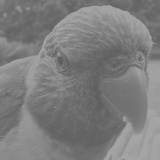
Experimental set-up for result 3 Different noise
Noise (in the test-data):
Unifom
Low contrast
High-pass filter
Low-pass filter
Eidolon perturbations
(Geirhos et al., 2019)
26 / 33
Notes:
IN-trained CNN generalize poorly towards many distortions ⬅ p.9 Dodge & Karam, 2017, Geiros et. Al. 2017/2018
SIN transfer well!
All distortions reported by Geirhos et al. (2018) with more than five different levels of sigal strength.
Eidolon = disruption of image structure across space and spatial scales
Blurring is still difficult for SIN – maybe because over-representation of high frequency signals in SIN through paintings (WHY DONT FIX THIS?)
More positive results for SIN+IN-training, evaluated on ImageNet-C (Gaussian, Shot, Impulse noise, Defocus, Glass, Motion blur, Snow, Frost, Fog, Contrast, Elastic, Pixelate, JPEG digital corrputions)

Slide 59
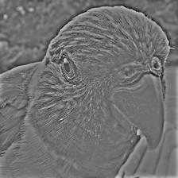
Experimental set-up for result 3 Different noise
Noise (in the test-data):
Unifom
Low contrast
High-pass filter
Low-pass filter
Eidolon perturbations
(Geirhos et al., 2019)
26 / 33
Notes:
IN-trained CNN generalize poorly towards many distortions ⬅ p.9 Dodge & Karam, 2017, Geiros et. Al. 2017/2018
SIN transfer well!
All distortions reported by Geirhos et al. (2018) with more than five different levels of sigal strength.
Eidolon = disruption of image structure across space and spatial scales
Blurring is still difficult for SIN – maybe because over-representation of high frequency signals in SIN through paintings (WHY DONT FIX THIS?)
More positive results for SIN+IN-training, evaluated on ImageNet-C (Gaussian, Shot, Impulse noise, Defocus, Glass, Motion blur, Snow, Frost, Fog, Contrast, Elastic, Pixelate, JPEG digital corrputions)

Slide 60

Experimental set-up for result 3 Different noise
Noise (in the test-data):
Unifom
Low contrast
High-pass filter
Low-pass filter
Eidolon perturbations
(Geirhos et al., 2019)
26 / 33
Notes:
IN-trained CNN generalize poorly towards many distortions ⬅ p.9 Dodge & Karam, 2017, Geiros et. Al. 2017/2018
SIN transfer well!
All distortions reported by Geirhos et al. (2018) with more than five different levels of sigal strength.
Eidolon = disruption of image structure across space and spatial scales
Blurring is still difficult for SIN – maybe because over-representation of high frequency signals in SIN through paintings (WHY DONT FIX THIS?)
More positive results for SIN+IN-training, evaluated on ImageNet-C (Gaussian, Shot, Impulse noise, Defocus, Glass, Motion blur, Snow, Frost, Fog, Contrast, Elastic, Pixelate, JPEG digital corrputions)

Slide 61
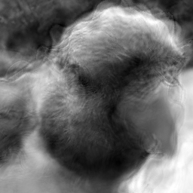
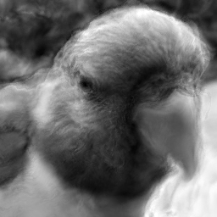
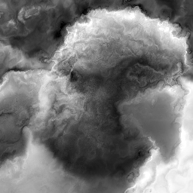
Experimental set-up for result 3 Different noise
Noise (in the test-data):
Unifom
Low contrast
High-pass filter
Low-pass filter
Eidolon perturbations
(Geirhos et al., 2019)
26 / 33
Notes:
IN-trained CNN generalize poorly towards many distortions ⬅ p.9 Dodge & Karam, 2017, Geiros et. Al. 2017/2018
SIN transfer well!
All distortions reported by Geirhos et al. (2018) with more than five different levels of sigal strength.
Eidolon = disruption of image structure across space and spatial scales
Blurring is still difficult for SIN – maybe because over-representation of high frequency signals in SIN through paintings (WHY DONT FIX THIS?)
More positive results for SIN+IN-training, evaluated on ImageNet-C (Gaussian, Shot, Impulse noise, Defocus, Glass, Motion blur, Snow, Frost, Fog, Contrast, Elastic, Pixelate, JPEG digital corrputions)

Slide 62
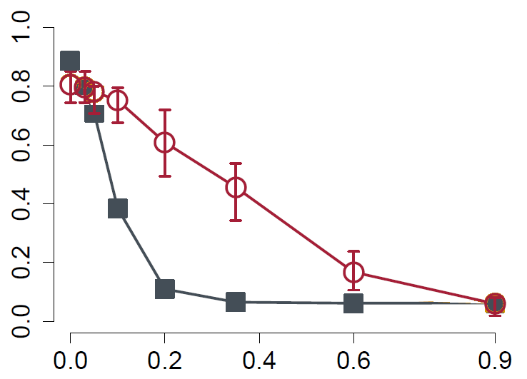
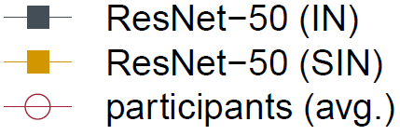


Experimental evaluation for result 3 Robustness from SIN
Classification accuracy (%)
Noise strength
(Geirhos et al., 2019)
27 / 33
Notes:
IN-trained CNN generalize poorly towards many distortions ⬅ p.9 Dodge & Karam, 2017, Geiros et. Al. 2017/2018
Eidolon = disruption of image structure across space and spatial scales
All distortions reported by Geirhos et al. (2018) with more than five different levels of sigal strength.
Blurring is difficutl for SIN – maybe because over-representation of high frequency signals in SIN through paintings (WHY DONT FIX THIS?)
More positive results for SIN+IN-training, evaluated on ImageNet-C (Gaussian, Shot, Impulse noise, Defocus, Glass, Motion blur, Snow, Frost, Fog, Contrast, Elastic, Pixelate, JPEG digital corrputions)

Slide 63
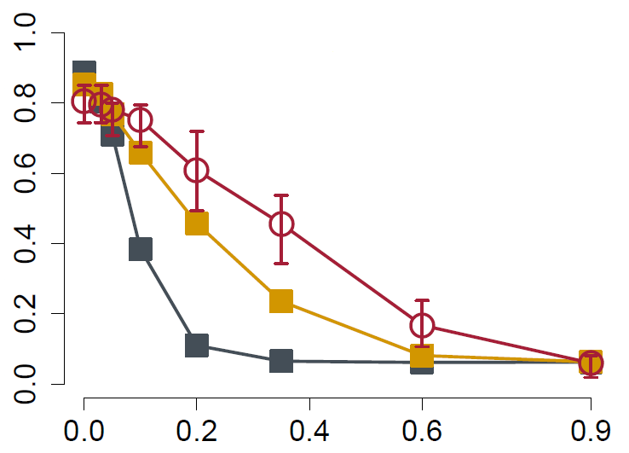
Experimental evaluation for result 3 Robustness from SIN
Classification accuracy (%)
Noise strength
(Geirhos et al., 2019)
27 / 33
Notes:
IN-trained CNN generalize poorly towards many distortions ⬅ p.9 Dodge & Karam, 2017, Geiros et. Al. 2017/2018
Eidolon = disruption of image structure across space and spatial scales
All distortions reported by Geirhos et al. (2018) with more than five different levels of sigal strength.
Blurring is difficutl for SIN – maybe because over-representation of high frequency signals in SIN through paintings (WHY DONT FIX THIS?)
Notice that the CNN has never seen these distortions before!!! (TRAINNIG POSSIBILITY)
More positive results for SIN+IN-training, evaluated on ImageNet-C (Gaussian, Shot, Impulse noise, Defocus, Glass, Motion blur, Snow, Frost, Fog, Contrast, Elastic, Pixelate, JPEG digital corrputions)

Slide 64
Conclusion
1. CNNs (mostly) use textures for the classification task
2. This texture-bias can be replaced by a shape-bias by using a suitable database
3. CNNs with a shape-bias are more robust to (unseen) noise
(Geirhos et al., 2019)
28 / 33

Slide 65
Criticism of the presented content
What was done by the „fine tuning“-step for the Shape-ResNet?
What are reasons for the focus on ResNet-50?
Why was only ONE cure conflict shape-texture used? Why not alternative parameters like colour, amount of objects, …?
Idea of SIN was to make the texture a noisance, keep the shape intact But, as stated by the authors: „a substantial fraction“ (2019, Geirhos et al., page 5) of output from the style-transfer was not recognizable (non-sense images). Why were no counter measures used? E.g. preserving the edges.
(Geirhos et al., 2019)
29 / 33
Notes:
Keep the shape intact: e.g.
add an only-edge/silhouette layer to the style-transfer,
use edge-preserving texture-replacements,
use image-variations other than stlye-transfer that keep the edges intact (like negative images)
„Humans can learn during the testing“ – not an actual (fixable) problem(?)

Slide 66
Criticism – Closely related questions (1/2)
Can the initially expected shape-hierarchy be interpreted as a texture-hierarchy? How does the SIN-CNN looks in the inside? (Deconvolutional NN, Feature visualization) What is the possible „error“ in the shape-hierarchy-hypothesis?
Does the Shape-ResNet perform better on negative images? (This was the mentioned counter example against the shape-hypothesis given by Hosseini et al. in 2018)
The improvements by the usage of SIN were much more prominent with the experiments with the Faster-RCNN implementation (by Ren et la., 2017) (Pascal VOC, MS COCO databases). Is this only database related or maybe related to the implementation, too?
30 / 33
Notes:
- Idea: There was never a shape-hierarchy, but rather texture-hierarchy. Since texture at a small scale consists of shapes, this might have been misinterpreted

Slide 67
Criticism – Closely related questions (2/2)
How was the performance agains adverserial input? What kind of adverserial input can fool the Shape-ResNet?
→ “…still susceptible to adversarial examples…" Geirhos to “The Register” 2020; https://www.theregister.com/2019/02/13/ai_image_texture/
Why was there no comment on Between-Class learning (Mix-up technique)? (e.g. Tokozume et al., 2018 and after the publication: Bhattacharjee et al. 2020) Is it possible that different biases lead to categorically different object detections?
31 / 33
Notes:
„The Register“ – british technology news cite
(Audience question at Geirhos talk at the ICLR 2019)
Between-Class learning: Originally for sounds: Mixing two images belonging to different classes with a random ratio. (Success because of CNNs treating images as waveforms.)

Slide 68
Criticism of the style of the paper
A „future work“ section is missing
The presentation of related work is misleading and rather distributed over the whole paper
32 / 33

Slide 69
Future work
What kind of styalizations work best for SIN?
Using both biases: Let the shape-bias guess and use texture-bias for verification if deemed suitable for the object (e.g. panther, leopard, jaguar).
Explore other applications of texture-bias besides object detection. E.g. semantic segmentation, instance segmentation, localization, …
Accieve a texture-bias in other ways. E.g. by
different changes or selections of the database,
changes to the CNN architecture,
use of loss functions,
other approaches or combinations of the above.
(In general: Answering open questions, e.g. given in my critic above.)
33 / 33
Notes:
- Do not dismiss texture information entirely – just do not only rely on it. It did a brilliant job so far.

Slide 70
Bibliography and references Basic
Robert Geirhos et al. ImageNet-trained CNNs are biased towards texture; increasing shape bias improves accuracy and robustness. arXiv preprint arXiv:1811.12231, 2018.
Pedro Ballester and Ricardo Matsumura de Ara´ujo. On the performance of GoogLeNet and AlexNet applied to sketches. In AAAI, pp. 1124–1128, 2016
Wieland Brendel and Matthias Bethge. Approximating CNNs with bag-of-local-features models works surprisingly well on ImageNet. In International Conference on Learning Representations, 2019
Supritam Bhattacharjee, Devraj Mandal and Soma Biswas. Multi-class Novelty Detection Using Mix-up Technique. In: The IEEE Winter Conference on Applications of Computer Vision. pp. 1400-1409. 2020
Leon A Gatys, Alexander S Ecker, and Matthias Bethge. Texture synthesis using convolutional neural networks. In Advances in Neural Information Processing Systems, pp. 262–270, 2015
Leon A Gatys, Alexander S Ecker, and Matthias Bethge. Image style transfer using convolutional neural networks. In Proceedings of the IEEE Conference on Computer Vision and Pattern Recognition, pp. 2414–2423, 2016
Robert Geirhos, Carlos M. Medina Temme, Jonas Rauber, Heiko H Sch¨utt, Matthias Bethge, and Felix A Wichmann. Generalisation in humans and deep neural networks. arXiv preprint arXiv:1808.08750, 2018
Hossein Hosseini, Baicen Xiao, Mayoore Jaiswal, and Radha Poovendran. Assessing shape bias property of Convolutional Neural Networks. arXiv preprint arXiv:1803.07739, 2018
Xun Huang and Serge Belongie. Arbitrary style transfer in real-time with adaptive instance normalization. In: Proceedings of the IEEE International Conference on Computer Vision. pp. 1501-1510, 2017

Slide 71
Bibliography and references Basic
A. Krizhevsky, I. Sutskever, and G. E. Hinton. ImageNet classification with deep convolutional neural networks. In Advances in Neural Information Processing Systems, pp. 1097–1105, 2012
Samuel Ritter, David GT Barrett, Adam Santoro, and Matt M Botvinick. Cognitive psychology for deep neural networks: A shape bias case study. arXiv preprint arXiv:1706.08606, 2017
Christian Szegedy, Wei Liu, Yangqing Jia, Pierre Sermanet, Scott Reed, Dragomir Anguelov, Dumitru Erhan, Vincent Vanhoucke, and Andrew Rabinovich. Going deeper with convolutions. In Proceedings of the IEEE Conference on Computer Vision and Pattern Recognition, pp. 1–9, 2015
Ondřej Texler et al. Interactive Video Stylization Using Few-Shot Patch-Based Training. arXiv preprint arXiv:2004.14489, 2020
Daniel LK Yamins, Ha Hong, Charles F Cadieu, Ethan A Solomon, Darren Seibert, and James JDiCarlo. Performance-optimized hierarchical models predict neural responses in higher visual cortex. Proceedings of the National Academy of Sciences, 111(23):8619–8624, 2014
Matthew D Zeiler and Rob Fergus. Visualizing and understanding convolutional networks. In European Conference on Computer Vision, pp. 818–833. Springer, 2014

Slide 72
Bibliography and references Other
Website of Robert Geirhos – 2020; https://robertgeirhos.com/
Github Repository of the paper: https://github.com/rgeirhos/texture-vs-shape/
The Register - 2020; https://www.theregister.com/2019/02/13/ai_image_texture/
Youtube – 2020; „Two Minute Papers“ by Károly Zsolnai-Fehér's https://www.youtube.com/channel/UCbfYPyITQ-7l4upoX8nvctg
Youtube – 2020; „Robert Geirhos: ImageNet-trained CNNs are biased towards texture (ICLR 2019 talk)”, Steven Van Vaerenbergh

Slide 73
Thank you for your attention!

Slide 74
Appendix

Slide 75
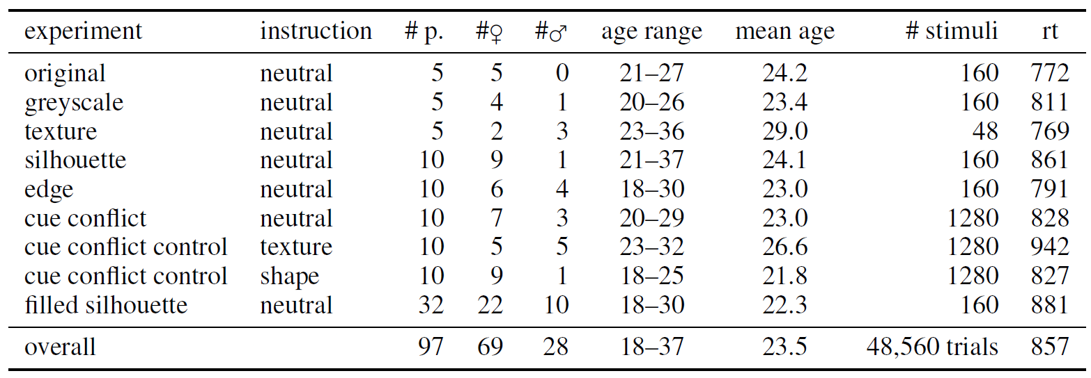
Experiments Setup
(Geirhos et al., 2029)

Slide 76
5 Experimental evaluation

Slide 77
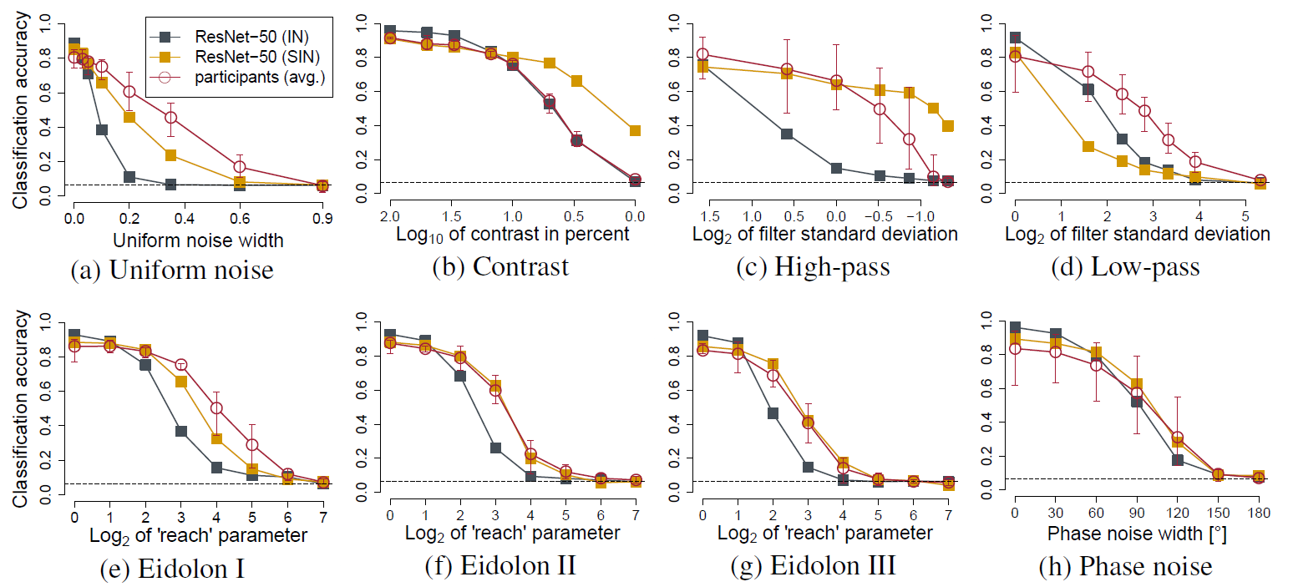
5 Experimental evaluation

Slide 78
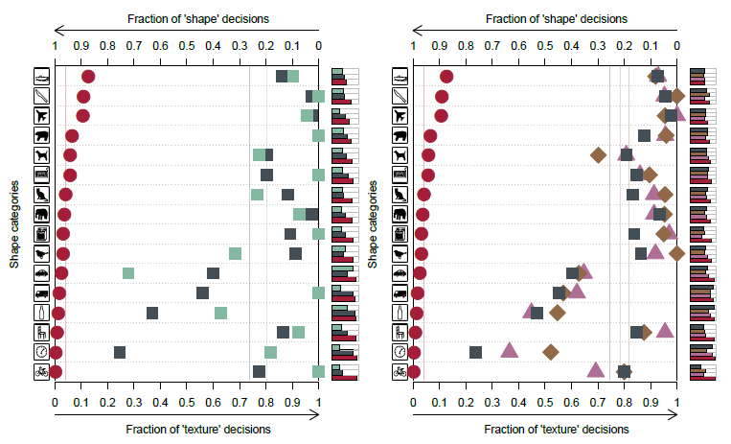
5 Experimental evaluation
26 / 26

Slide 79
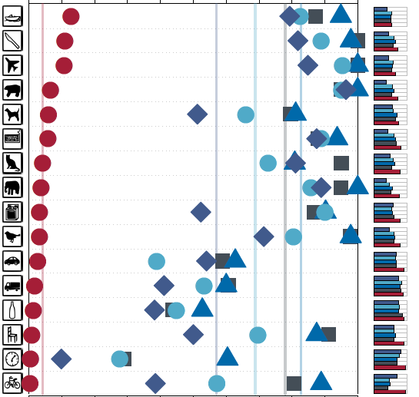
Experiments Setup
cat
Fraction of `shape‘ decisions
1.0 | 0.9 | 0.8 | 0.7 | 0.6 | 0.5 | 0.4 | 0.3 | 0.2 | 0.1 | 0.0
Shape categories
elephant
13 / 26

Slide 80
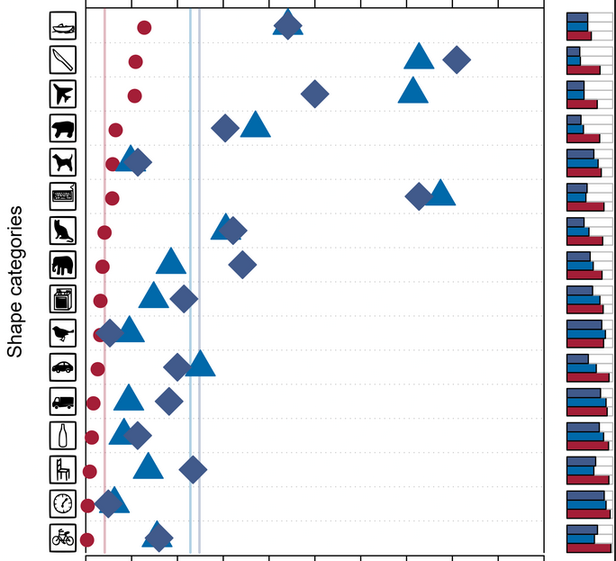
Experiments Trained on SIN – AlexNet and VGG-16
cat
Fraction of `shape‘ decisions
1.0 | 0.9 | 0.8 | 0.7 | 0.6 | 0.5 | 0.4 | 0.3 | 0.2 | 0.1 | 0.0
elephant
13 / 26

Slide 81
Other slides

Slide 82
ImageNet-trained CNNs are biased towards texture; increasing shape bias improves accuracy and robustness )
1995 by Yann LeCun and Yoshua Bengio
Notes:
AlexNet
(KRIZHEVSKY, Alex; SUTSKEVER, Ilya; HINTON, Geoffrey E. Imagenet classification with deep convolutional neural networks. In: Advances in neural information processing systems. 2012. S. 1097-1105.)

Slide 83
Task(s)
TASK: Elaborate what exactly a CNN does learn –
if the ImageNet database is used
Result: 1. The CNN did learn (mostly) use textures for the classification task
Subtask: Can and should this texture-biased learning be avoided?
Solution: 2. Yes it can be avoided by using a modified database
3. Avoiding it this way leads to an improved method
1 / 26

Slide 84
Method
Terminology
DEF: feature = attribute learned by CNN
DEF: cue = physical attribute
Idea: Assume that both CNN and humans rely on shape (shape being a feature and a cue). Now present images with clear shapes but a contradicting cue (in this case texture).
→ Use texture-shape cue conflicts
1 / 26
Notes:
If performance of CNNs is BAD: Shape is not an important feature (because it is still detectable)
If performance of CNNs/human is GOOD: The contradicting cue is not an important feature - because the detectable shape was sufficient for the classification.
Quantify the texture & shape biases in humans & CNN

Slide 85
Method
DEF: texture-shape cue conflict:
“style-transfer“
(Gatys et al., 2016)
(Geirhos et al., 2029)
1 / 26

Slide 86
Experiments Setup
9 Experiments:
13 / 26
Notes:
9 Experiments (PIE CHART?)
6 major
5: object recognition, different available features (Figure 2)
1: Cue conflices (Figure 1, S. 4)
3 control

Slide 87
Method
Terminology
DEF: feature = attribute learned by CNN
DEF: cue = physical attribute
Idea: Reduce the the relation of present textures with the solution – for testing and or training (If the performance of the CNNs drops but not the performance of the human, this could indicate that the CNN classify using a different approach. Quantify the texture & shape biases in human & CNN)
Use texture-cure conflics

